Slide 1
A short history of using
in research and tech companies
Vienna R Meetup, Dec 17th
Christoph Töglhofer

Slide 2
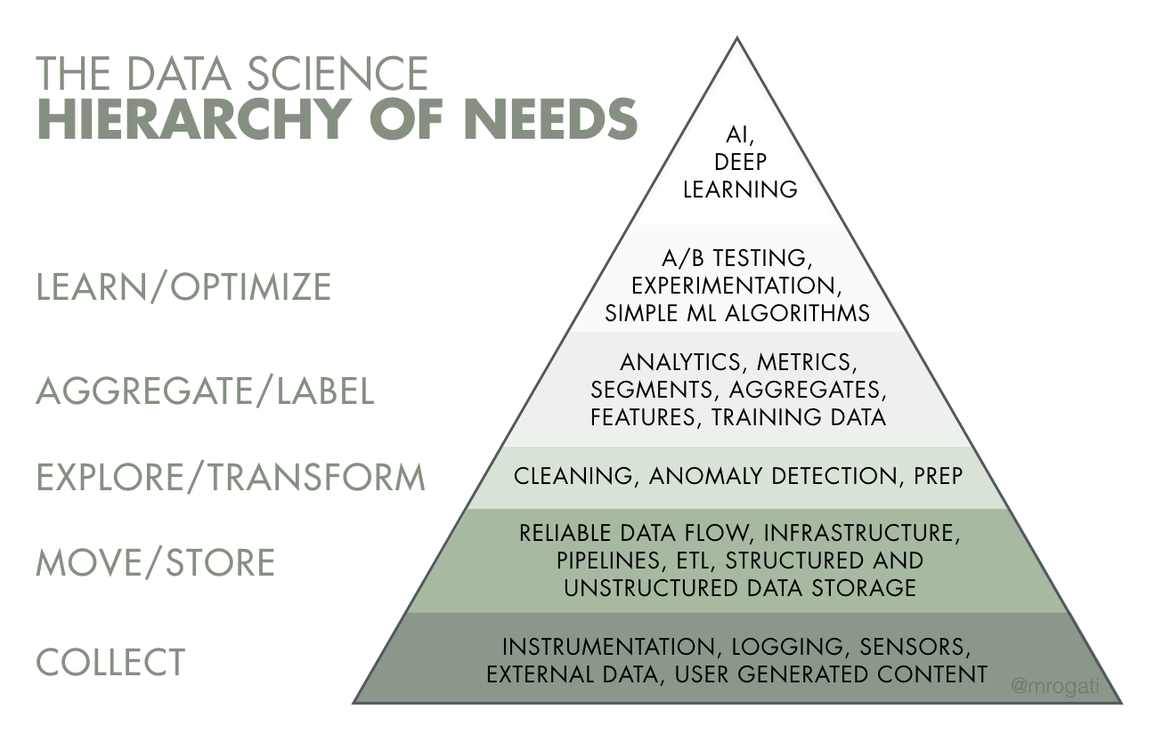
Source: Monica Rogati’s Medium post “The AI Hierarchy of Needs”

Slide 3
Data science skill evaluation

Slide 4
A T

Slide 5
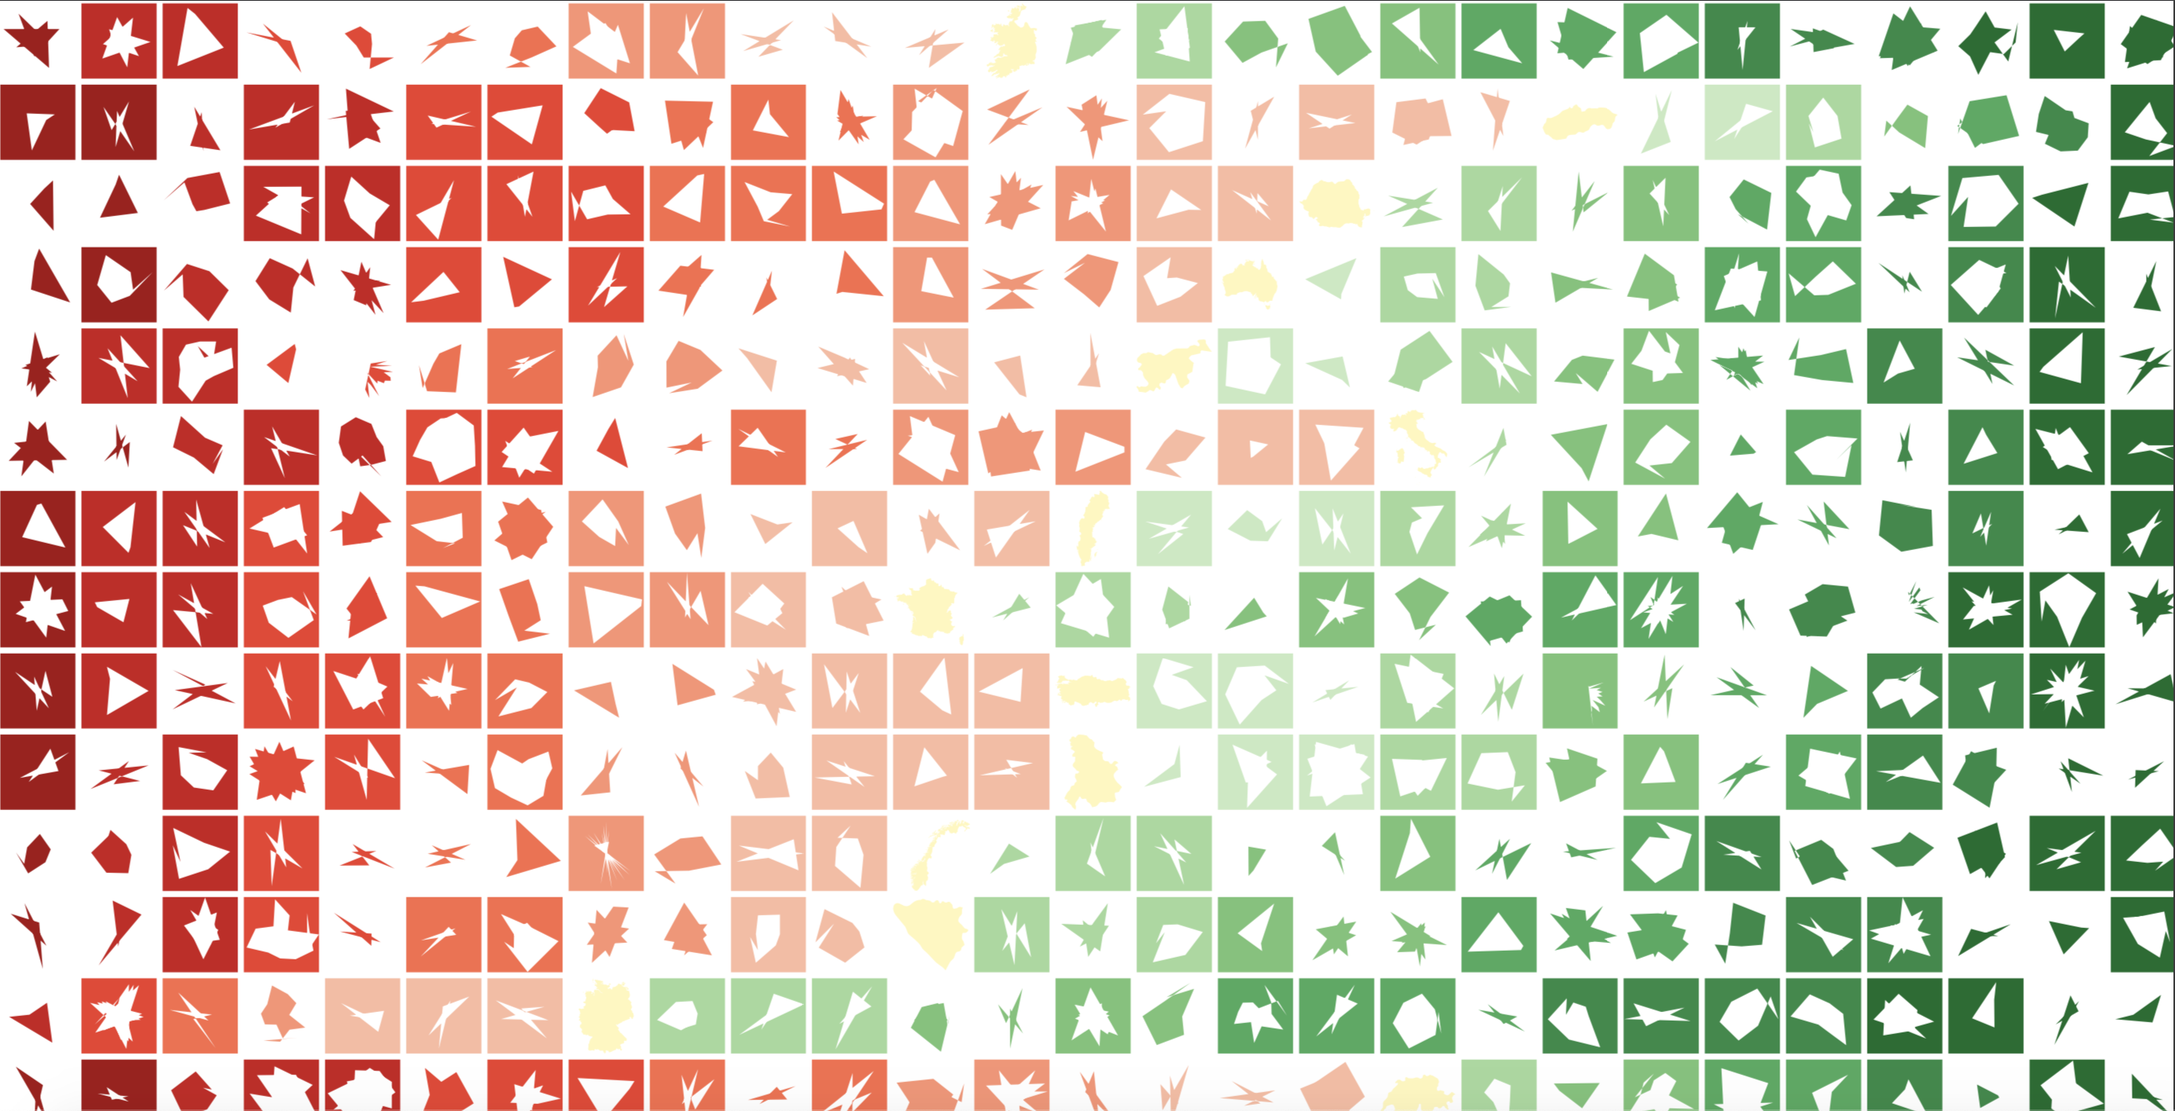

Slide 6
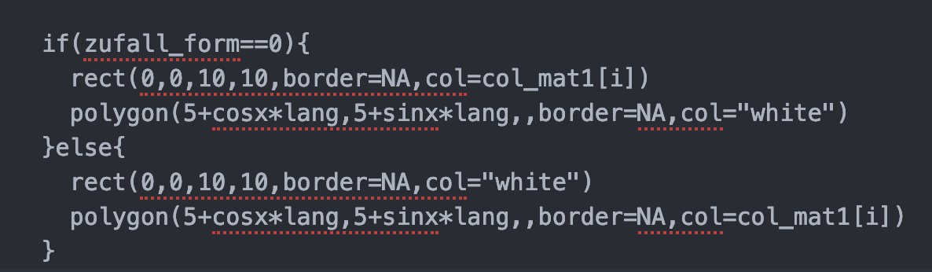

Slide 7

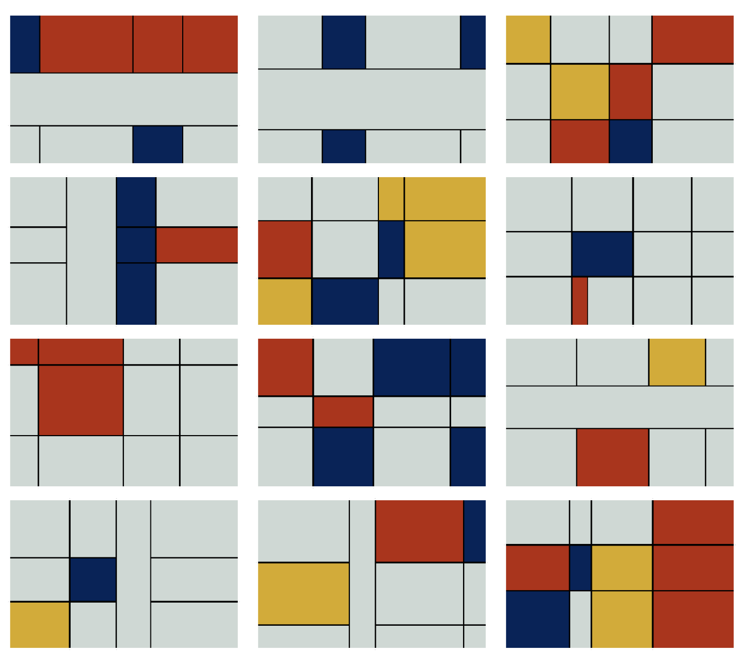
https://non-productivity-linked-ideas.shinyapps.io/Art_plot/

Slide 8
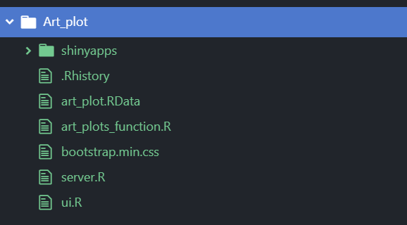
https://non-productivity-linked-ideas.shinyapps.io/Art_plot/

Slide 9
isk
is a combination of the probability of an event
and its potential impact

Slide 10
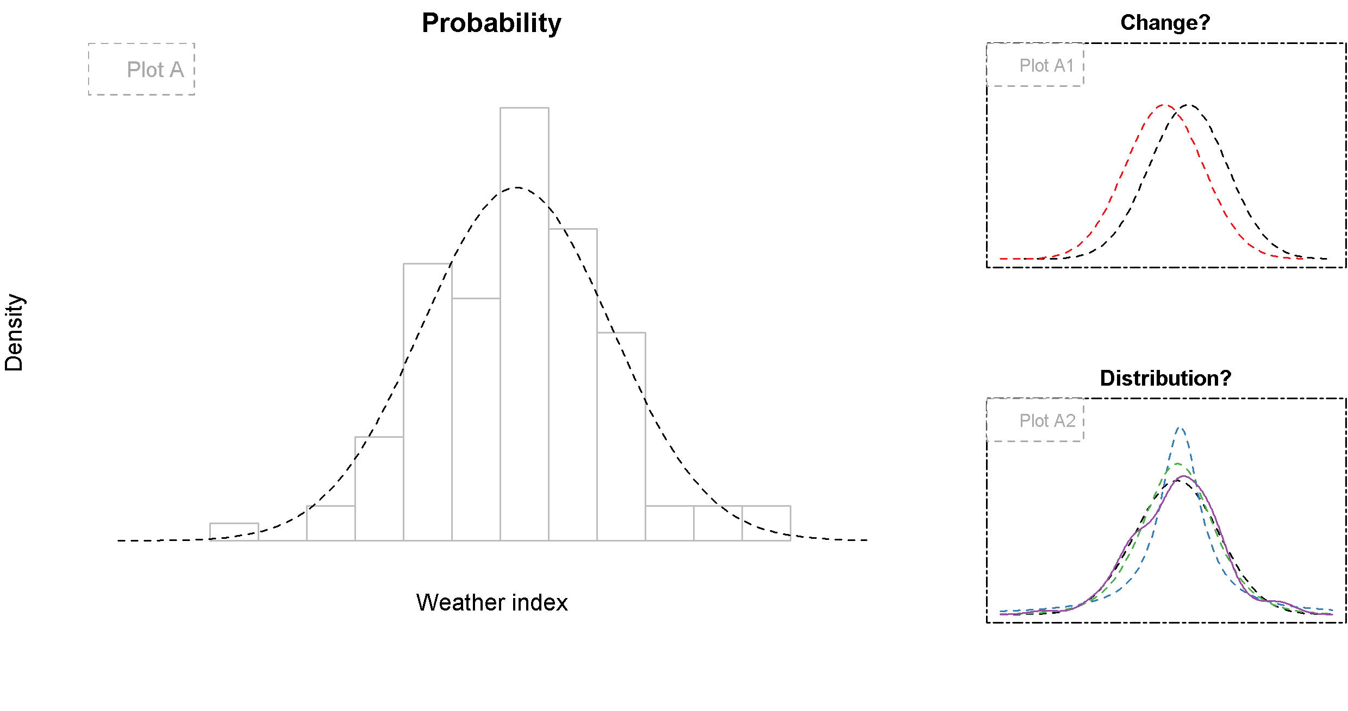

Slide 11
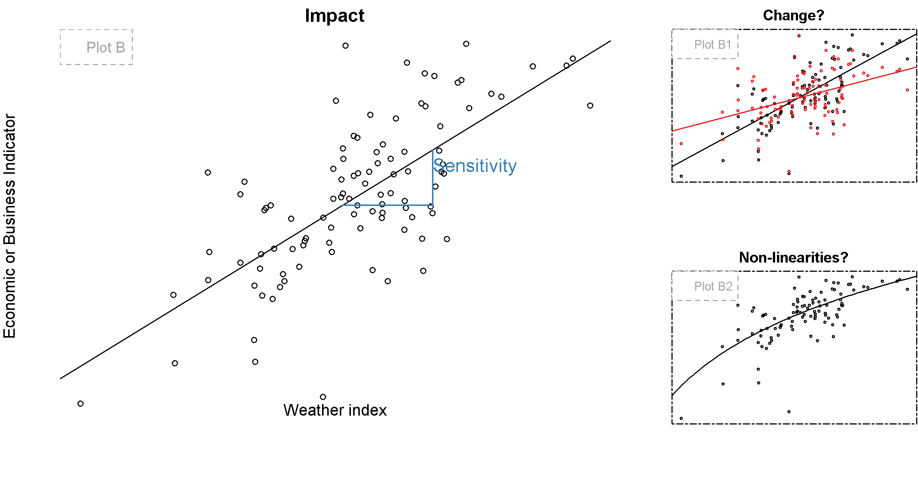

Slide 12
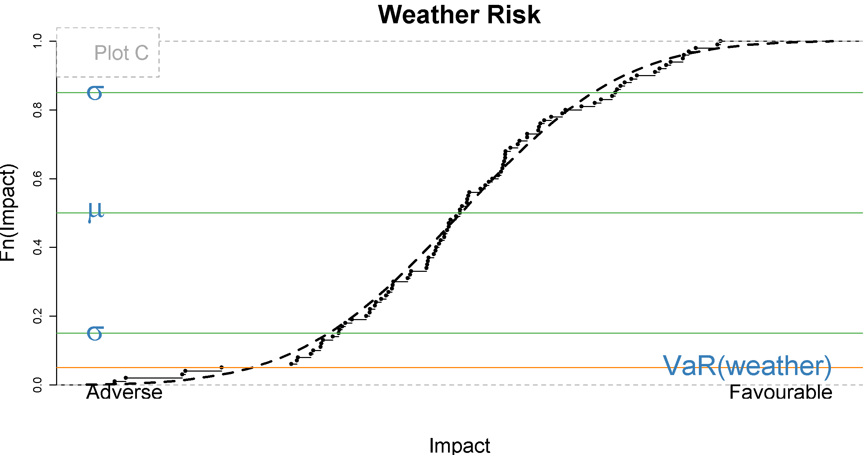

Slide 13
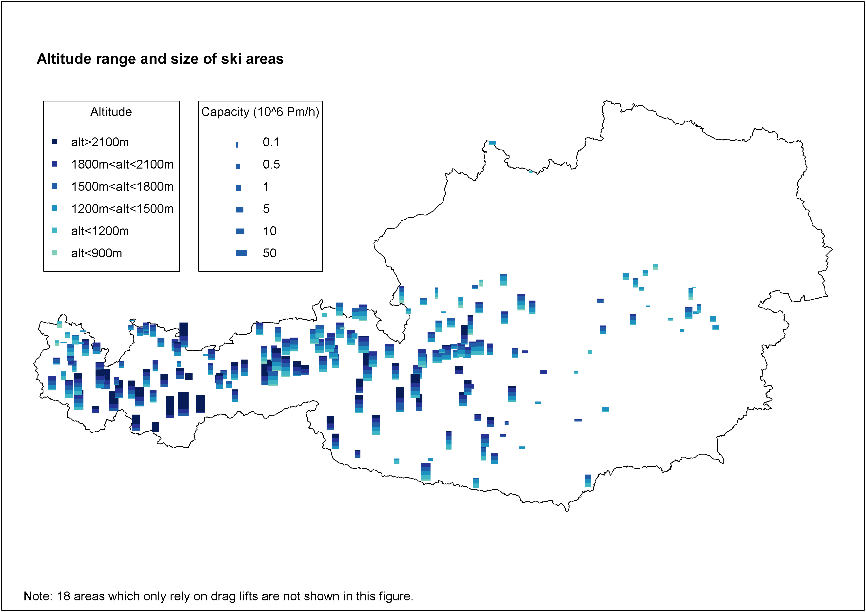

Slide 14
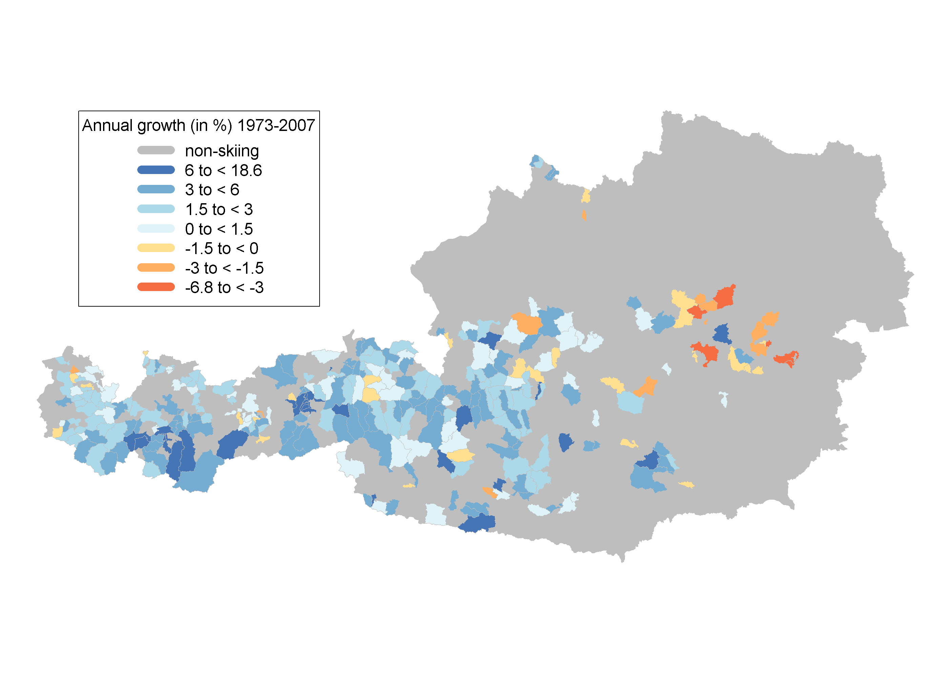
Overnight Stays

Slide 15
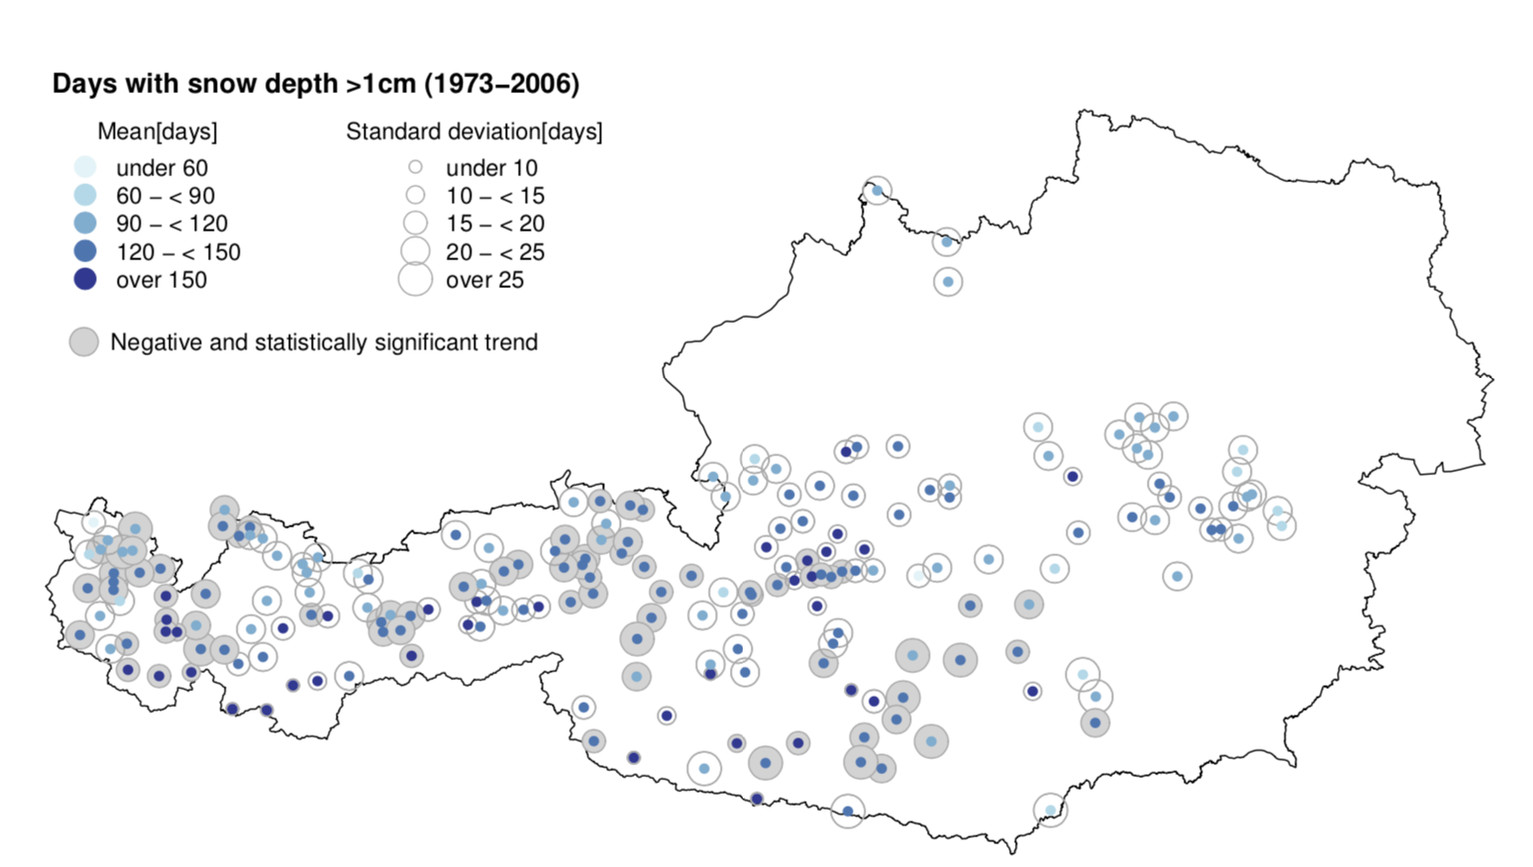

Slide 16
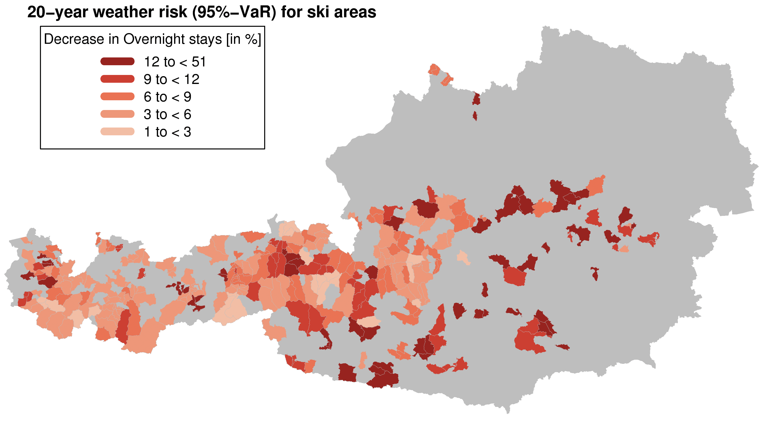

Slide 17
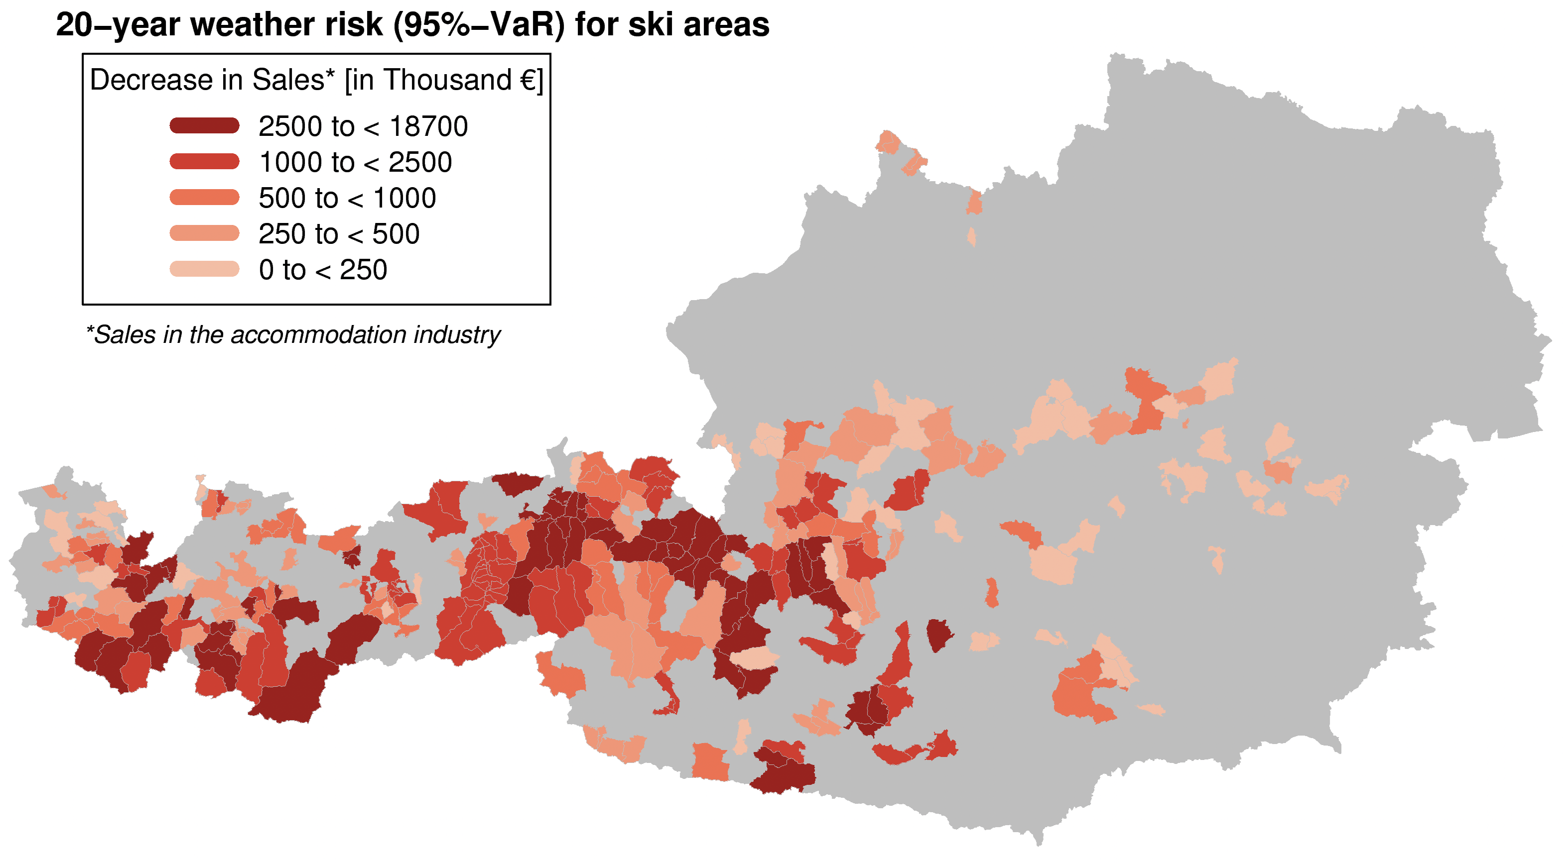

Slide 18
Elect icity

Slide 19
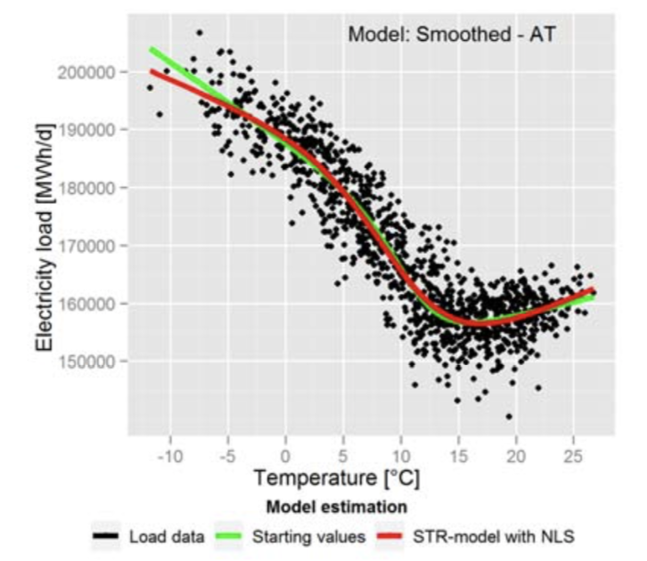
C. Töglhofer, C. Habsburg-Lothringen, F. Prettenthaler, N. Rogler, M. Themessl, 2012:
Impacts of Climate Change on Electricity Demand

Slide 20
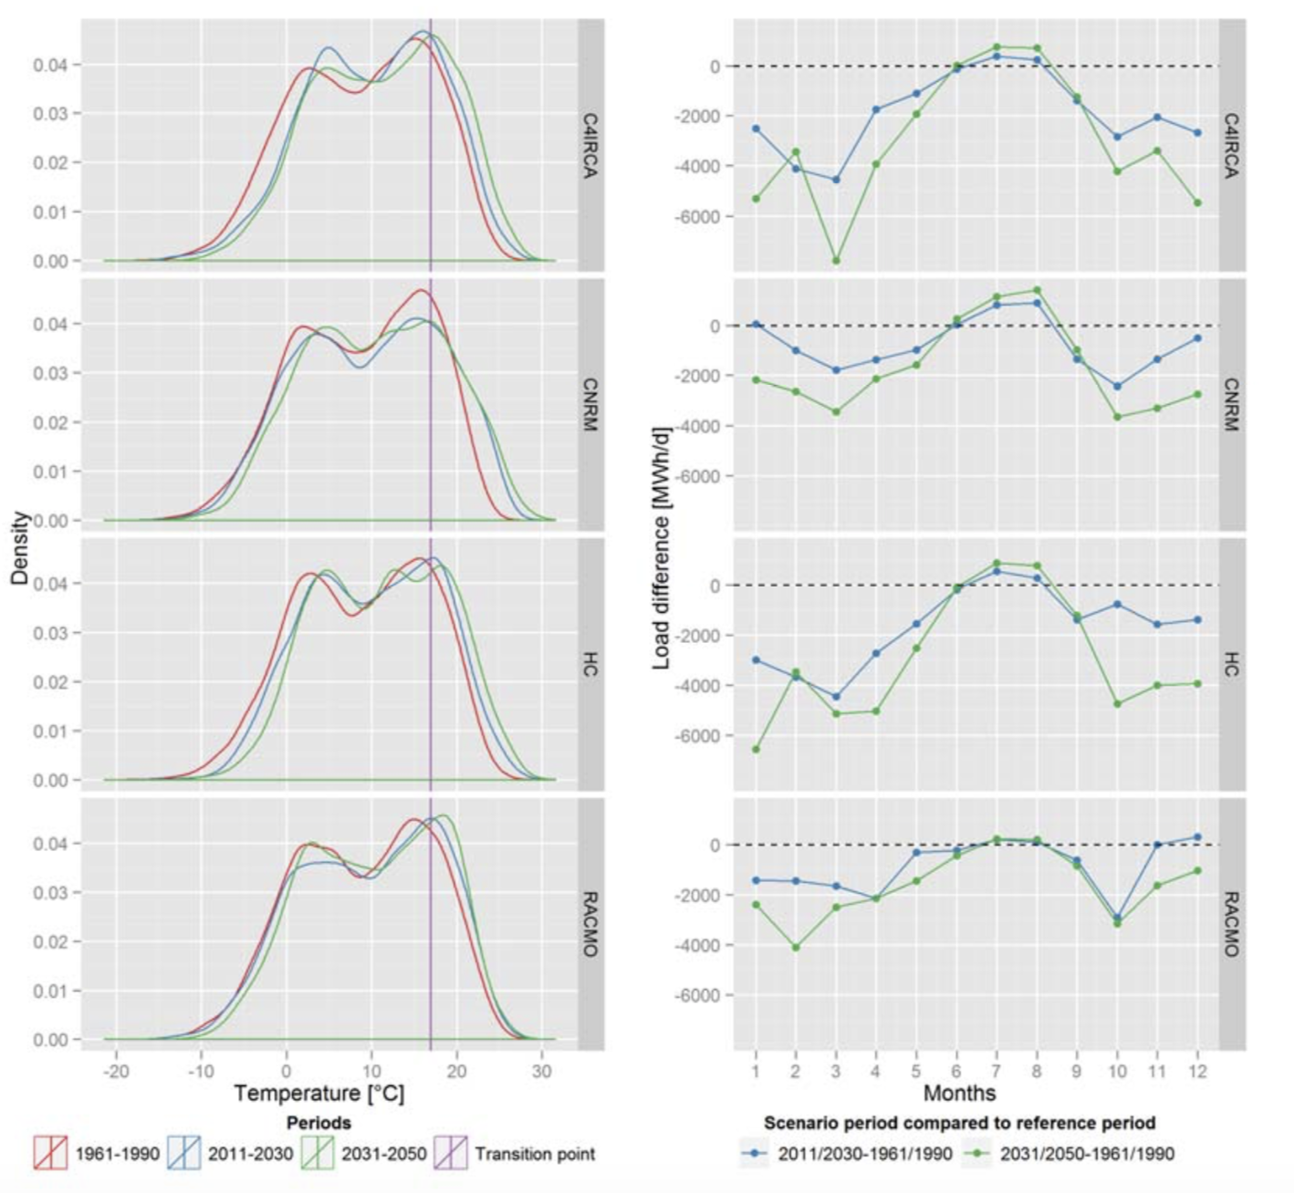

Slide 21
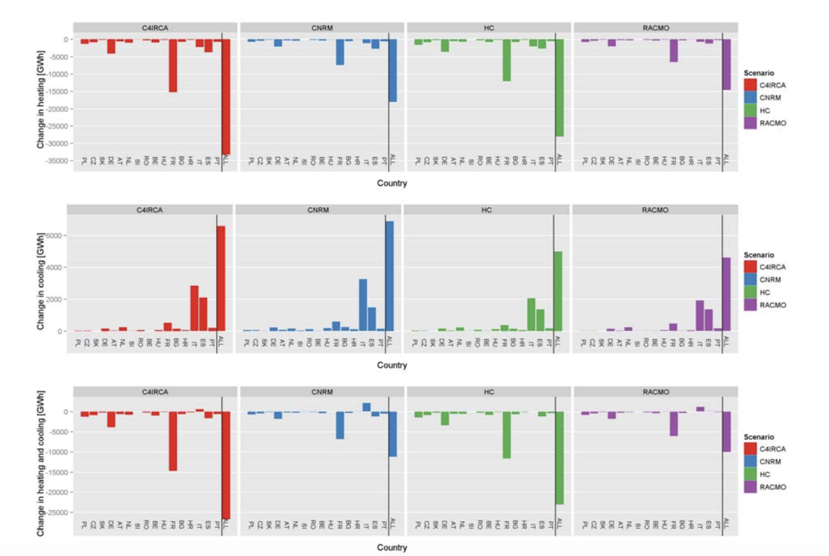

Slide 22
You Life

Slide 24
Perfo mance

Slide 26

Ge ge

Slide 27
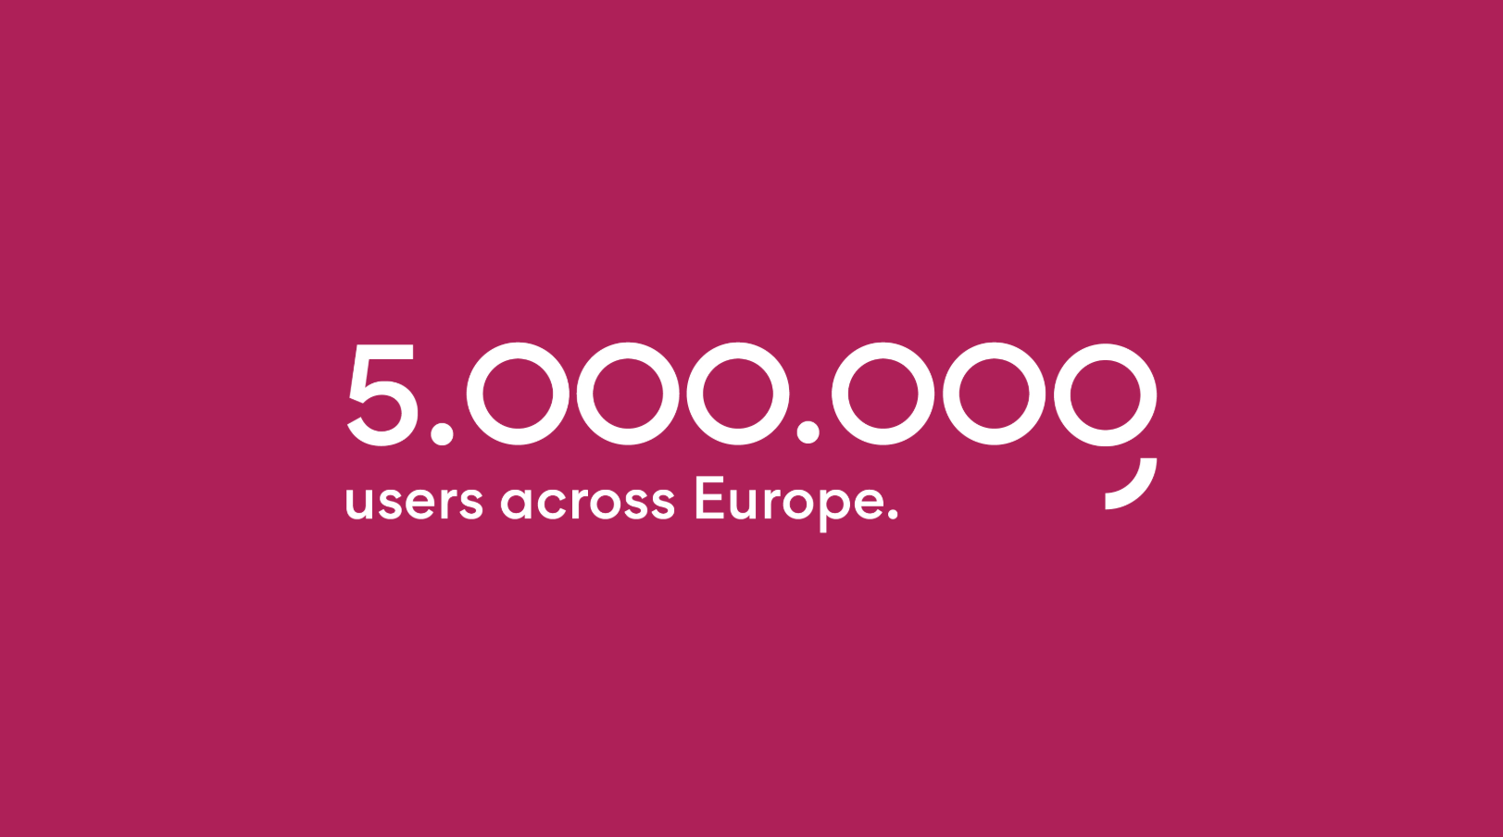

Slide 28

https://george-labs.com/

Slide 29
Insights Sharing
Reporting Engine
Markdown
Flex Dashboard
Notebooks
Knowledge repo
https://github.com/airbnb/knowledge-repo
https://rmarkdown.rstudio.com/flexdashboard/

Slide 30
Tech Behind

Slide 31
P we up

Slide 32

https://george-labs.com/

Slide 33
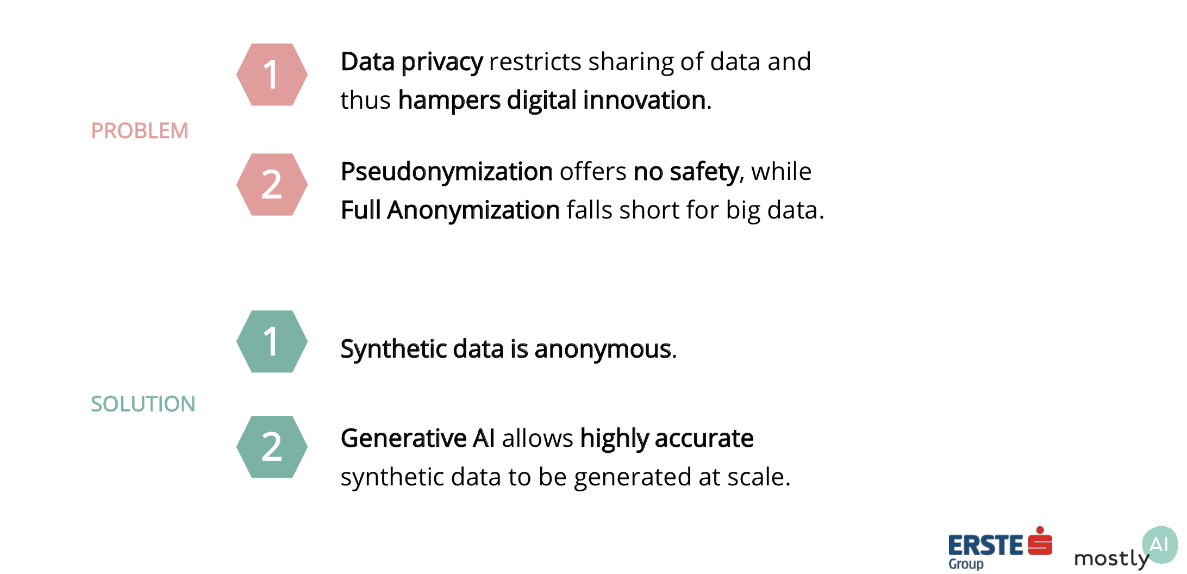
M. Platzer, C. Toeglhofer 2018: Privacy-Preserving Sharing of Financial Transaction Data with Deep Generative Models

Slide 34
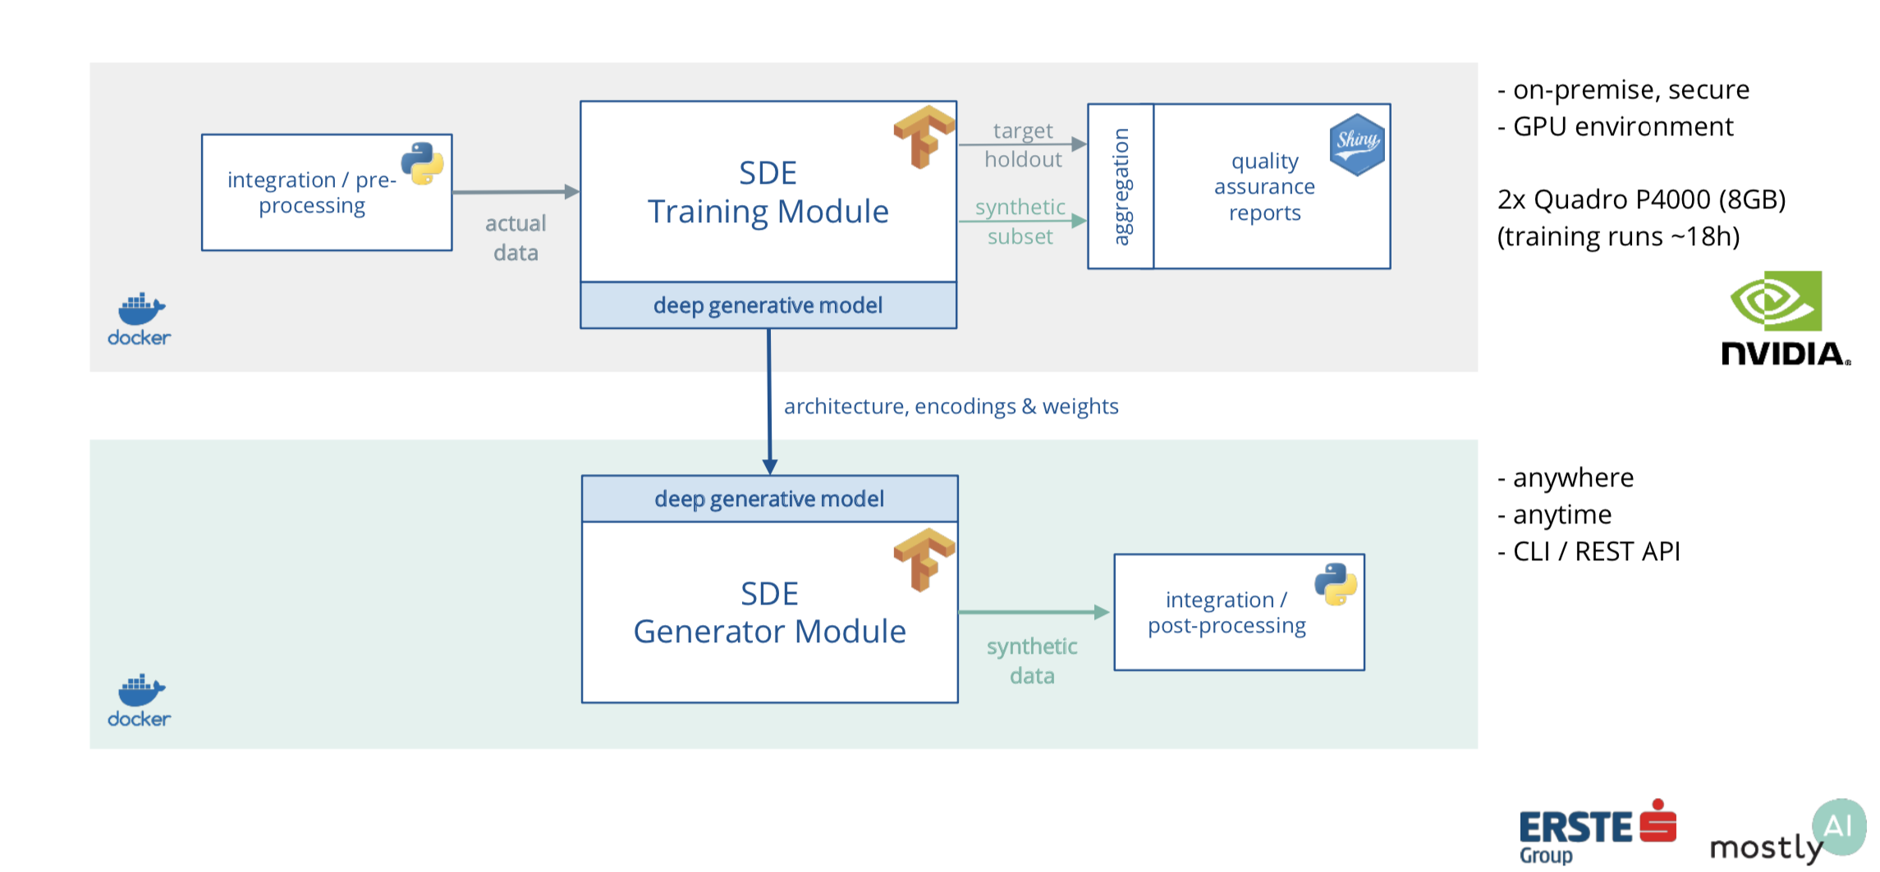
Tech Behind

Slide 35
https://github.com/ctoegi
https://at.linkedin.com/in/christoph-t%C3%B6glhofer-1870ab185

Slide 36


Thank you

